Slide 1
Vchar3
Platform that enables you to coordinate the care of your loved one(s)

Slide 2
Vchar3 – Blockchain based Platform for Care Management system
Vchar3
vChar3 (pronounced veechaar means “Think” in Hindi) was founded on a premise that with technologies like blockchain, machine learning and IOT, we can transform the market for care management by creating a platform that enables the following:
Putting you the ”Individual” in-charge of all aspects of your care.
Easy collaboration and sharing of care information amongst the care givers using mobile apps.
Clear chain of custody of key health information and access granted only to persons authorized.
Immutable record of care that can be vital and can be shared with health care providers as needed.
Create a broader ecosystem of care providers that can provide additional services thru the platform. (e.g. transportation (uber/Lyft), meals ( meal kit providers), adult day care, legal services ( Living will, legal directives, guardianships etc), quality of med records, finance/Tax, Insurance ( Medicare/Medicaid))
As people live longer we all have questions like these:
Where can I find help with meals and medication”?
Will my insurance cover this
Who can accompany me to the social security office
Who can provide transportation to my mom or dad to go to the doctors office next week.
Notes:
Process of discovery and determination with rigor to qualify and quantify how comeing together with same objectives is beneficial each of us and to consumer of health and well-being goods and services

Slide 3
Vchar3 – Blockchain based platform for care coordination
Vchar3
Taking care of an elderly parent is never easy for the adult children. They have their own families to take care of along with their busy work schedules. If there are many siblings, the care can be shared amongst them.
But then how to do you make sure everyone is informed about what decisions were made, who is taking mom/dad to the doctors next week, to the social security office the following week etc.
Blockchain based platform for care coordination.
Vchar3 will provide a blockchain based platform that will enable the caregivers in the family to coordinate the care of their loved one.
The data itself will be stored in the blockchain which provides full encryption and immutability (data cannot be deleted or updated).
Mobile app for caregivers to capture and share care information about their loved ones.
Vchar3 mobile app will enable each care giver to easily capture the basic information about mom or dad’s condition.
In case mom and dad are fairly independent, they can use the app to provide updates on basic activities like ”I had my breakfast at 8.00 AM, had lunch at noon, had my medication at 1 PM, went for a walk at 4 PM,” etc.
Voice enabled natural language search to find relevant content related to your care queries.
Vchar3 platform will source content relevant for providing care from publicly available data sources ( National Institute of Health, American Heart Association, American diabetics association, Alzheimer's association, etc.).
Vchar3 will use machine learning techniques to enable voice enabled natural language queries by care givers
e.g. “My elderly dad fell down, what should I do?”
“Where are the best places to buy crutches online?”
Notes:
Process of discovery and determination with rigor to qualify and quantify how comeing together with same objectives is beneficial each of us and to consumer of health and well-being goods and services

Slide 4
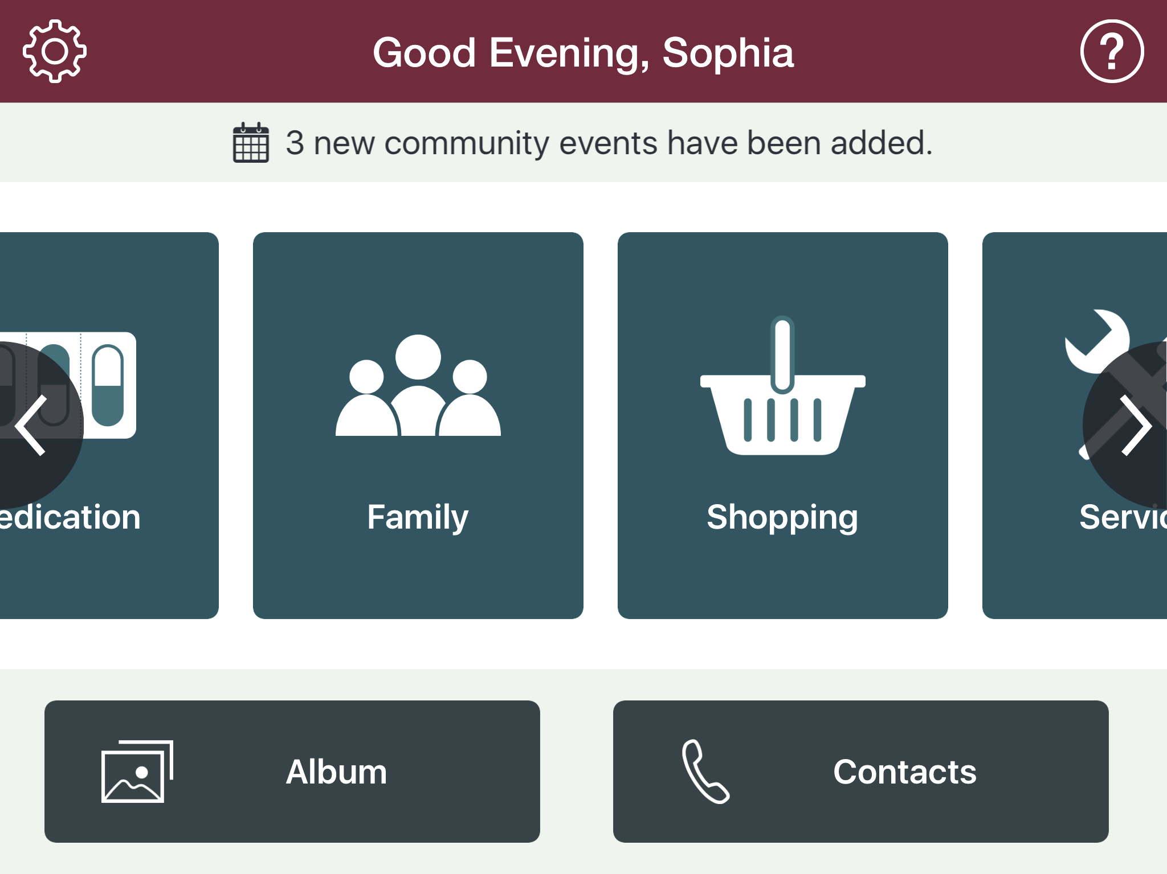
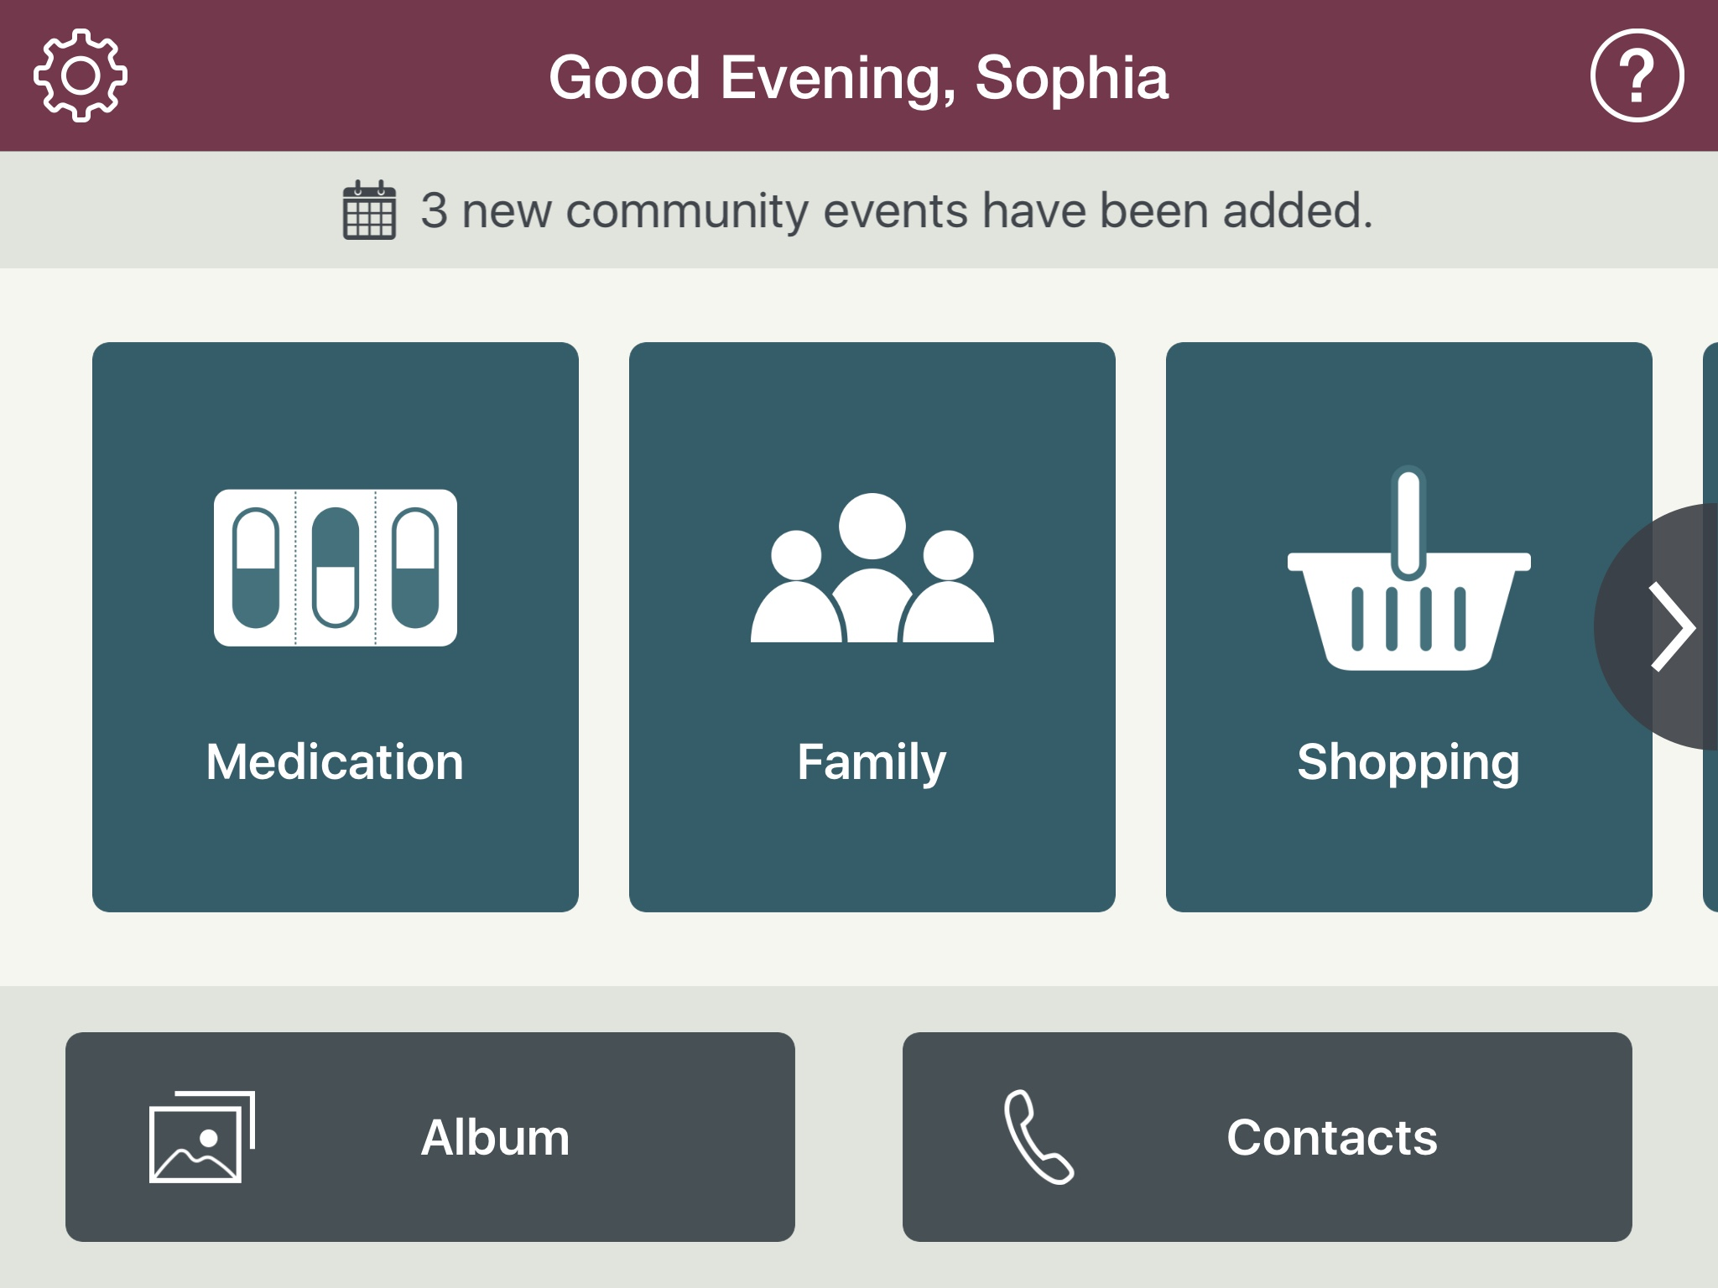
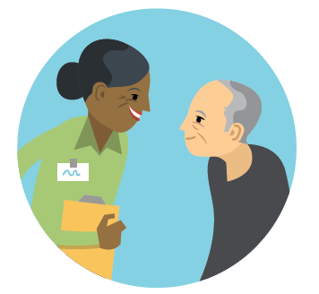
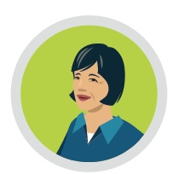
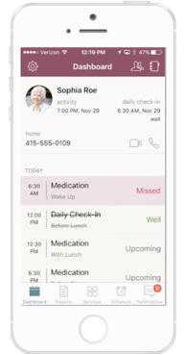
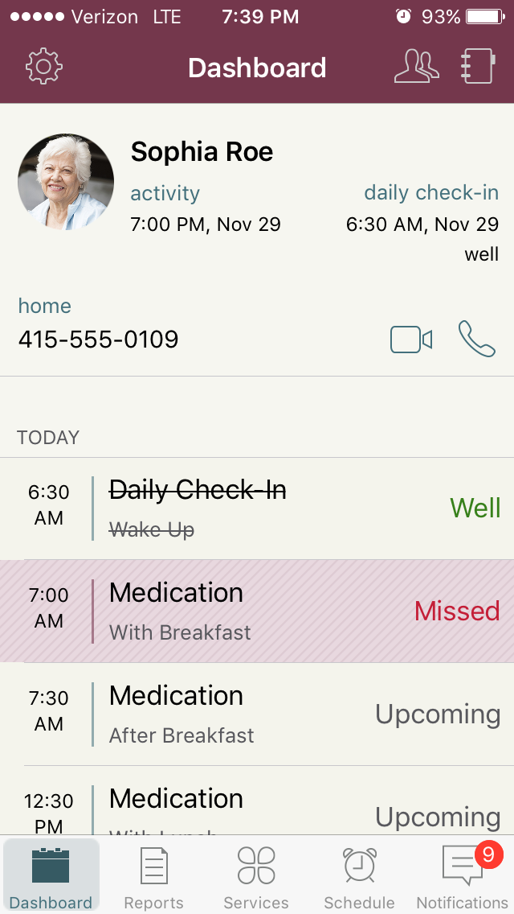

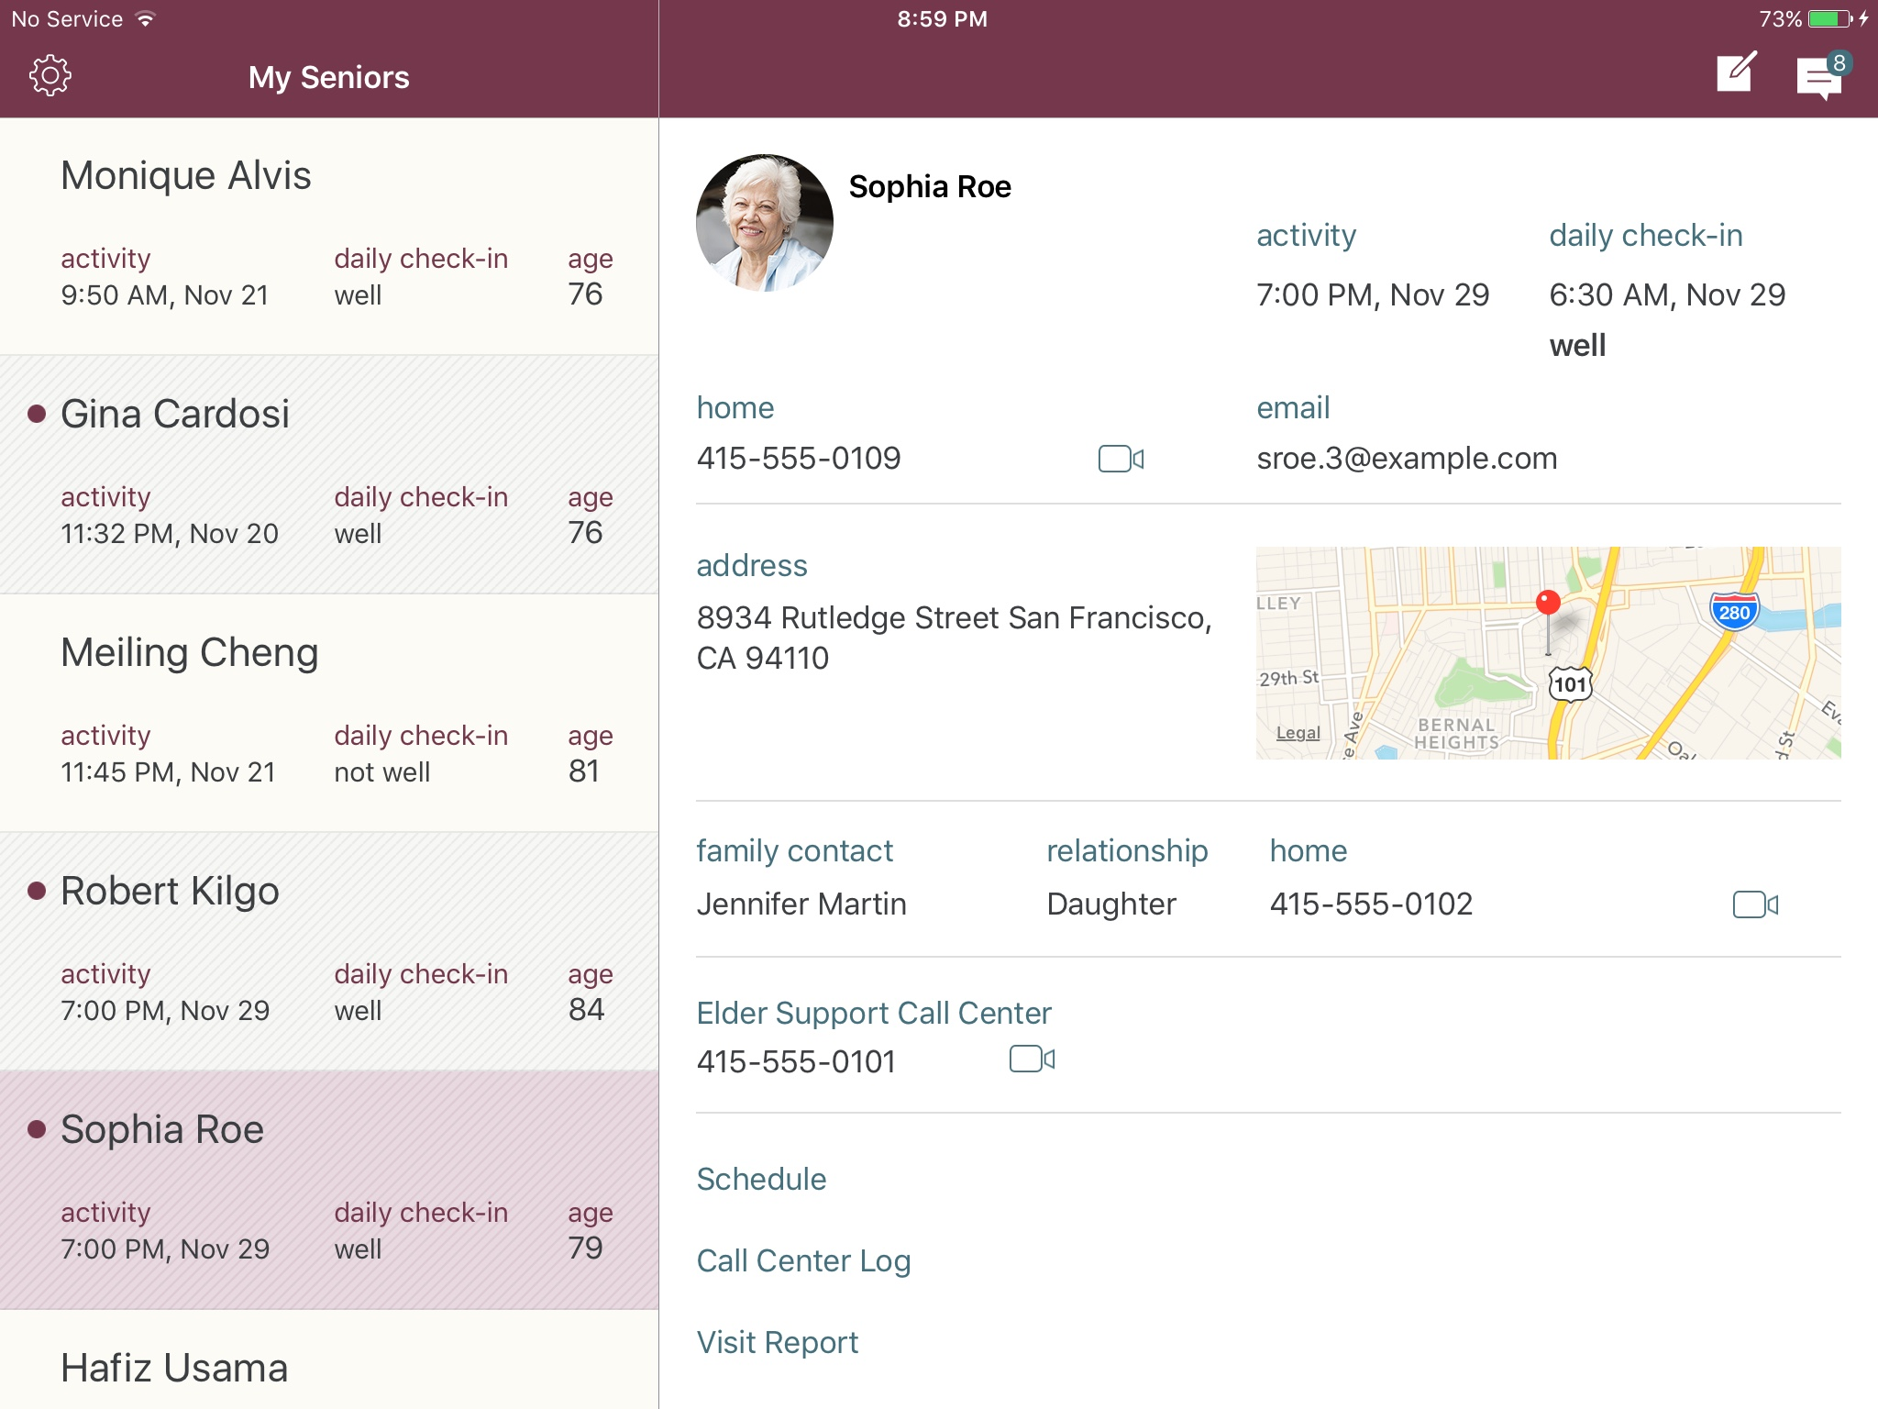

Vchar3 – Blockchain based Platform for Care Coordination
Caregiver1 –
Daughter
Elder at Home
Caregiver2 - Son
Caregiver 3 – care providers
Family / Loved Ones

Slide 5
Tech Stack
Develop a mobile app that will run on ios and Android.
Will use React Native and Redux as the core development tools for the apps. This is so we can have one code base for the mobile platforms.
Progressive and responsive Web App using React and Redux to ensure
The backend system will be a Node.js, Express and MongoDB. In addition the Hyperledger Fabric blockchain will be used for consent management, health records etc,
Mobile app
React Native
Redux for managing state
Passport MiddleWare, Redux Thunk
Security is very important. Ensure TLS
Use ES6 javascript
Authentication using JWT Tokens and OAUTH2.
Ensure use of logging Frameworks (redux-logger others)
Develop a common Error handling module
Multi-Language Support to be enabled ( in order to support English and Spanish and then add other languages later on).

Slide 6
Tech Stack
Avoid font sizes smaller than 16 pixels (depending of course on device, viewing distance, line height etc.).
Let people adjust text size themselves.
Reduce the distance between interface elements that are likely to be used in sequence (such as form fields), but make sure they’re at least 2 millimeters apart.
Avoid blue for important interface elements.
Buttons on touch interfaces should be at least 9.6 millimeters diagonally (for example, 44 × 44 pixels on an iPad) for ages up to 70, and larger for older people.
Interface elements to be clicked with a mouse (such as forms and buttons) should be at least 11 millimeters diagonally.

Slide 7
Tech Stack
Server and Web app
React with Redux
Redux for managing state
Passport MiddleWare, Redux Thunk
Security is very important. Ensure HTTPS everywhere
Use Helmet in Node.js to ensure that HTTPS is not downgraded to http
Use ES6 javascript
Authentication using JWT Tokens and OAUTH2.
Ensure use of logging Frameworks (redux-logger others)
Develop a common Error handling module
Multi-Language Support to be enabled ( in order to support English and Spanish and then add other languages later on).

Slide 8
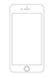
JSON Web Data
Nginx
Web Server
Node.js/Express
MongoDB (Mlab)
Hyperledger Fabric
Mobile App
With React/Redux
Redis
Google Cloud
IBM Cloud

Slide 9
Modules
User Profile
Basic User Information
User Health Profile
Disease Tracking Profile
What type of information should we track for specific conditions
Care Circles
Invite family members to your care circle.
Invite other providers to your care circle
Consent Manager
Give consent to care givers to create/update/Read Only your Care Information
Give Consent to External parties ( Hospitals, other care Providers ) access to your care notes and Health Records
Remove Consent
View Consent History/Audit
Care Notes
Daily Vitals and Vitals based on type of health Condition
See Tread history of vitals
Ability to Print care notes/vitals

Slide 10
Modules
Daily Notes
Be able to connect monitoring devices via BLE to app
Ability to talk and add notes
Query / Search Notes
Medication Adherence
Track Adherence
Enter Prescription information
Use camera and Google Visual API to capture Pill Box info
Show history of medication use
Check for ADR ( Adverse Drug Reactions) against Public API
Update Medication Info with (NIH ReNorm Standard , FDA National Drug Code, FDA Unique Ingredient If=dentifier, VA National Drug Ref etc) – These will be API Calls
Print Medication usage
My Health Records
Add Health Records into the system by taking a picture of Discharge Summary
Request Electronic Health Record from your doctor/Hospital via API ( Cerner, Epic, BlueButton 2.0)
Print Health Records
Give/Revoke consent to share your records

Slide 11
Modules
My Appointments
Calendar of all Doctors and other appointments
Synch up with Google Cal/Outlook
Automatically add medications to the calendar
Alert/Reminders
My Health Dashboard
Show a dashboard of your health
Be able to see trends over time
Insurance
Add Insurance Information
Use Camera to take a picture of insurance card (Front and Back) to capture and store insurance info ( Call to Google Vision API)
Consent Manager
Be able to provide consent to care givers/Providers to view/add care information
Ability to consent to sharing specific health information

Slide 12
Modules
Legal Information
Add Legal information about Healthcare needs of provider
By State
Guardianship
Healthcare Directives ( Advanced Directives)
(POLST – Physicians orders for Life-Sustaining Treatment)
Nutrition
Meal Plans
Diet Plans
Track eating habits
Care Providers
Add care Providers to your Care Circle
Store
Order Meal Plans

Slide 13
User
Profile
Medication
Health Records
Appointments
Insurance
Care Tracking
Consent
Meal Plans
Hospital/Clinic
Master
Care Circle
Disease Tracking
Profile
Legal
Health
Dashboard
Security
Authentication
Alerts
Notifications
Logging/
Error Handling
External Devices
Speech to Text
Visual
Recognition
Google Cloud

